Slide 1

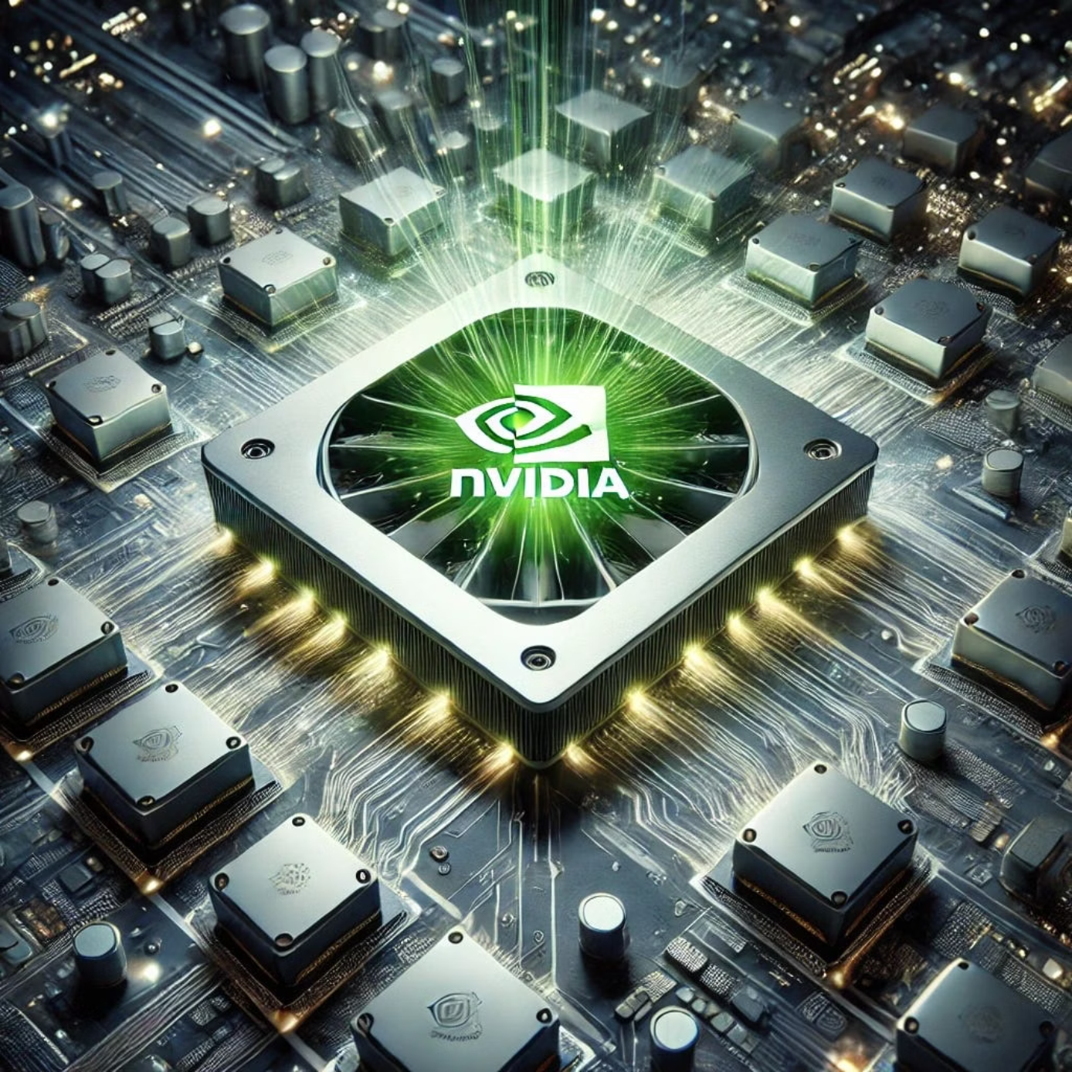
CS131 Fall 2025 Semester Project - Pierce
CUDA: Compute Unified Device Architecture
By Harut Payaslyan
Professor Yuen Y.

Slide 2
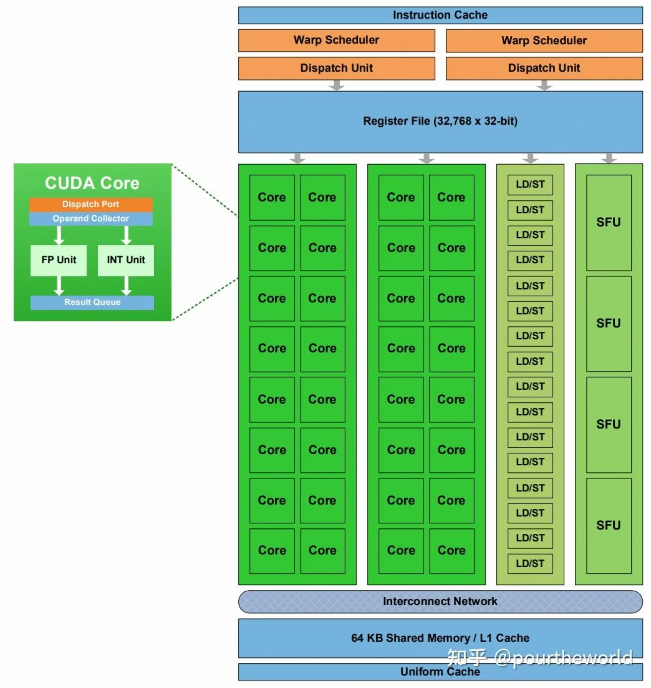
Introduction
What is CUDA?
CUDA is NVIDIA's parallel computing platform and programming model that enables developers to harness the massive parallel processing power of GPUs for general-purpose computing tasks beyond traditional graphics rendering.
Introduced in 2006, CUDA revolutionized high-performance computing by making GPU acceleration accessible through familiar programming languages like C, C++, and Python.

Slide 3
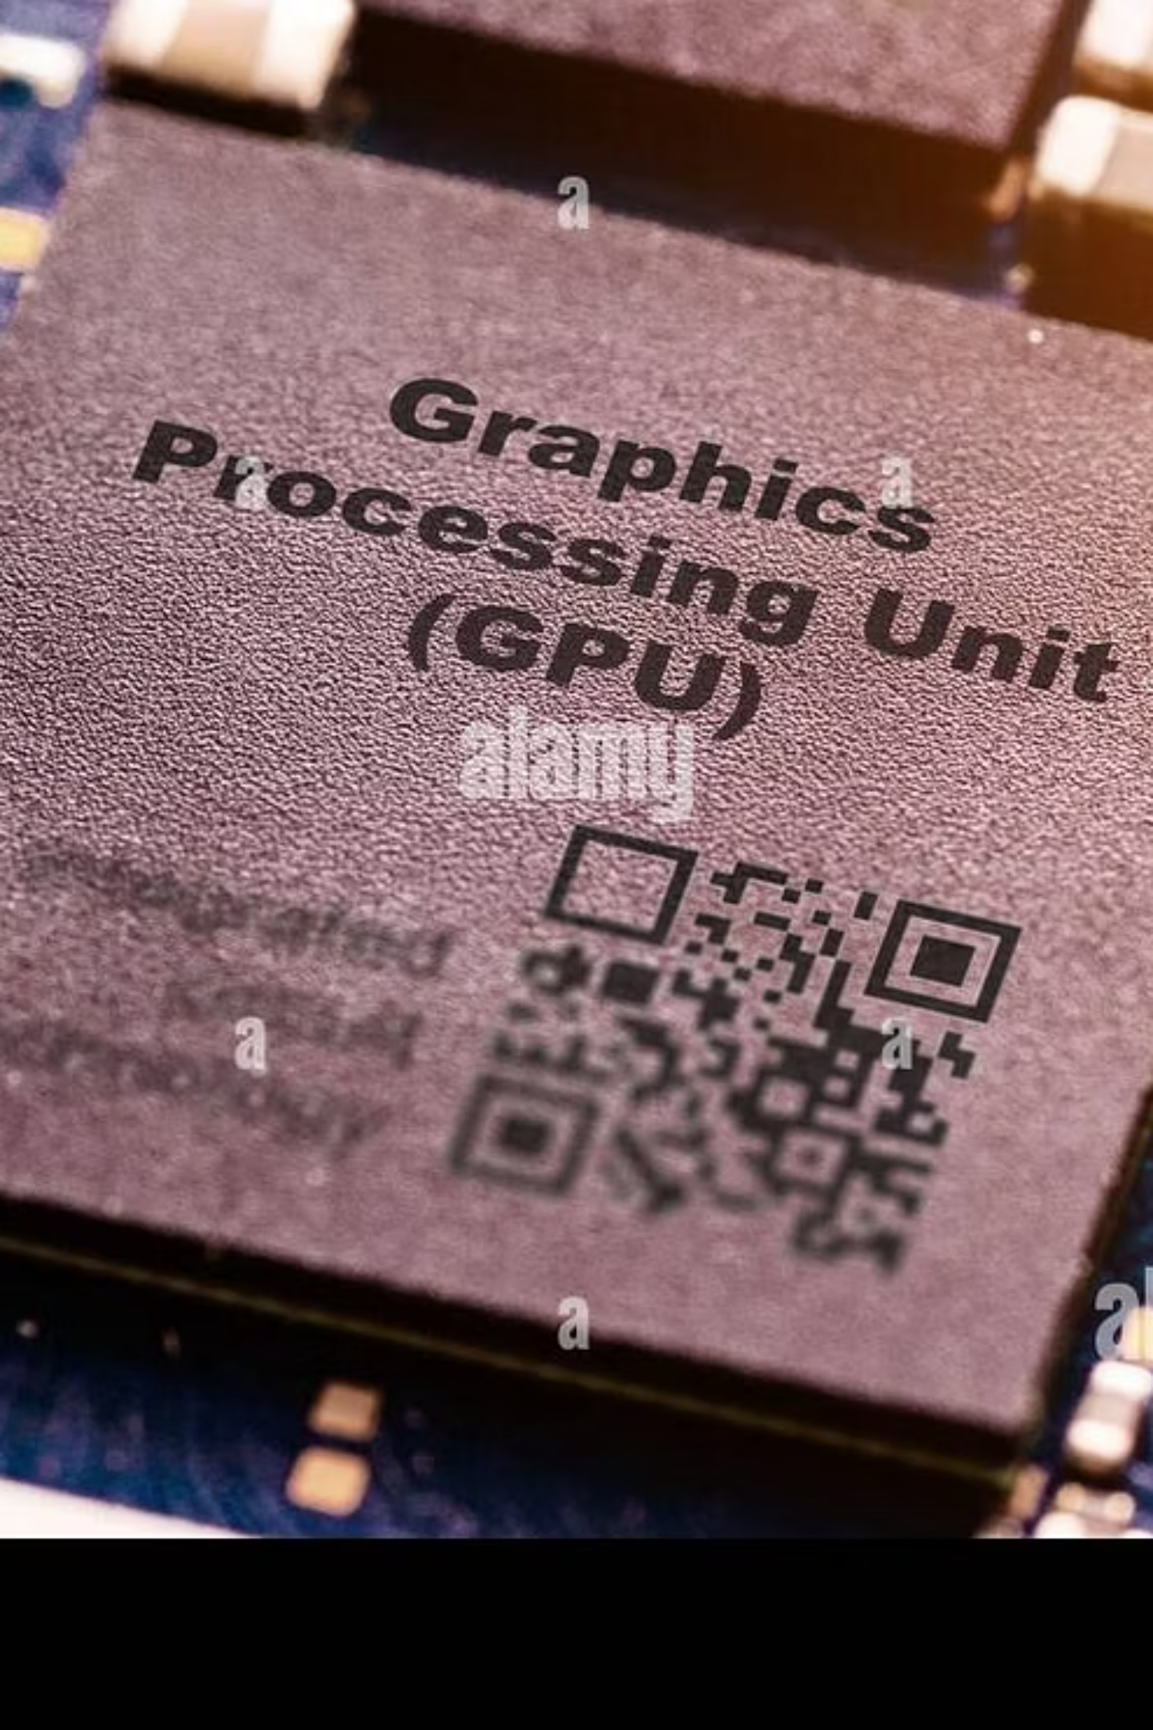
The GPU Architecture Advantage
Thousands of Cores
High Memory Bandwidth
Modern GPUs contain thousands of smaller, efficient cores designed for parallel execution, compared to CPUs with fewer, more powerful cores.
GPUs feature high-bandwidth memory systems capable of transferring hundreds of gigabytes per second, essential for data-intensive applications.
SIMT Architecture
Single Instruction Multiple Thread execution allows thousands of threads to execute the same instruction on different data simultaneously.

Slide 4
CUDA Programming Model
1
2
3
Define the Kernel
Allocate GPU Memory
Transfer Data
Write parallel functions (kernels) that execute on the GPU, specifying the computation each thread performs.
Use cudaMalloc() to allocate device memory and prepare data structures for GPU processing.
Copy input data from host (CPU) memory to device (GPU) memory using cudaMemcpy().
4
5
Launch Kernel
Retrieve Results
Execute the kernel with specified grid and block dimensions, distributing work across GPU threads.
Copy computed results back to host memory and free GPU resources with cudaFree().

Slide 5
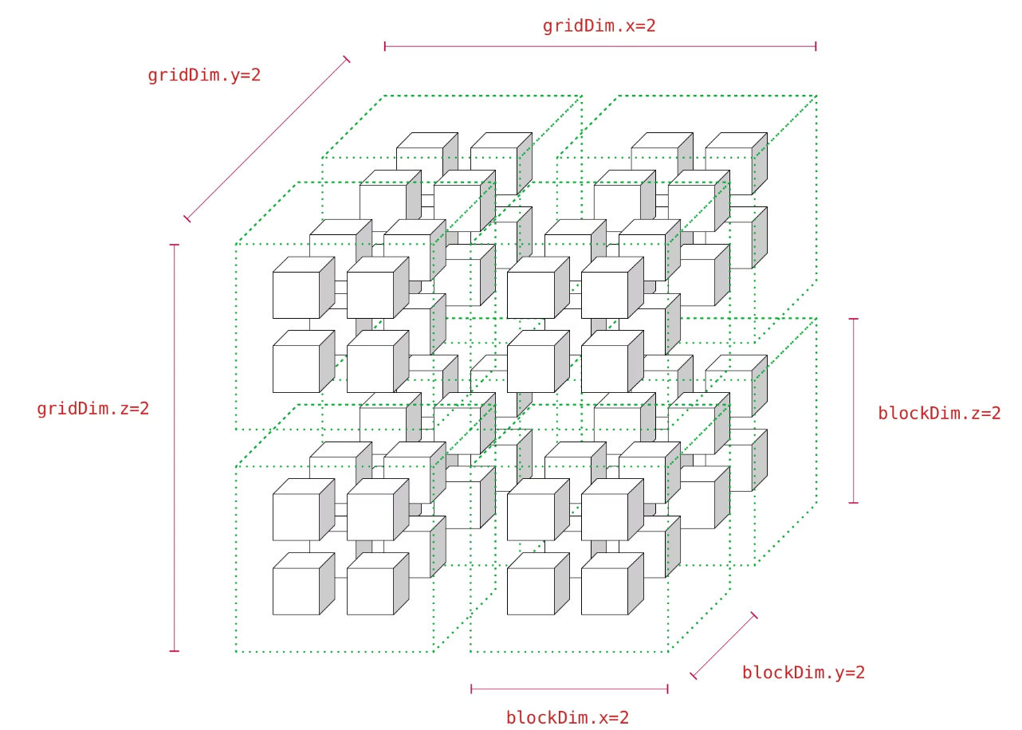
Thread Hierarchy
CUDA organizes threads into a hierarchical structure for efficient parallel execution:
Threads: Individual execution units grouped into blocks
Blocks: Collections of threads that share memory and can synchronize
Grids: Arrays of blocks launched together in a single kernel call
This hierarchy maps naturally to GPU hardware, with blocks scheduled on streaming multiprocessors (SMs) and threads executing in groups of 32 called warps.

Slide 6
Memory Hierarchy in CUDA
Global Memory
Shared Memory
Large capacity (GBs) but slowest access. Accessible by all threads across all blocks. Persists for the application lifetime.
Fast, low-latency memory shared among threads within a block. Limited size (~48KB) but crucial for performance optimization.
Registers
Constant & Texture Memory
Fastest memory, private to each thread. Automatically managed by compiler but limited in quantity per thread.
Read-only cached memories optimized for specific access patterns, ideal for lookup tables and spatial data.

Slide 7





Real-World Applications
Medical Imaging
Accelerating CT and MRI reconstruction for 3D visualization in real-time and rapid diagnostic analysis.
Deep Learning
Training neural networks for computer vision, natural language processing, and AI with massive speedups.
Financial Modeling
High frequency trading algorithms, risk analysis, and Monte Carlo simulations to process millions of scenarios.
Scientific Computing
Weather simulation, molecular dynamics, computational fluid dynamics, and climate modeling at previously unreachable scales.

Slide 8
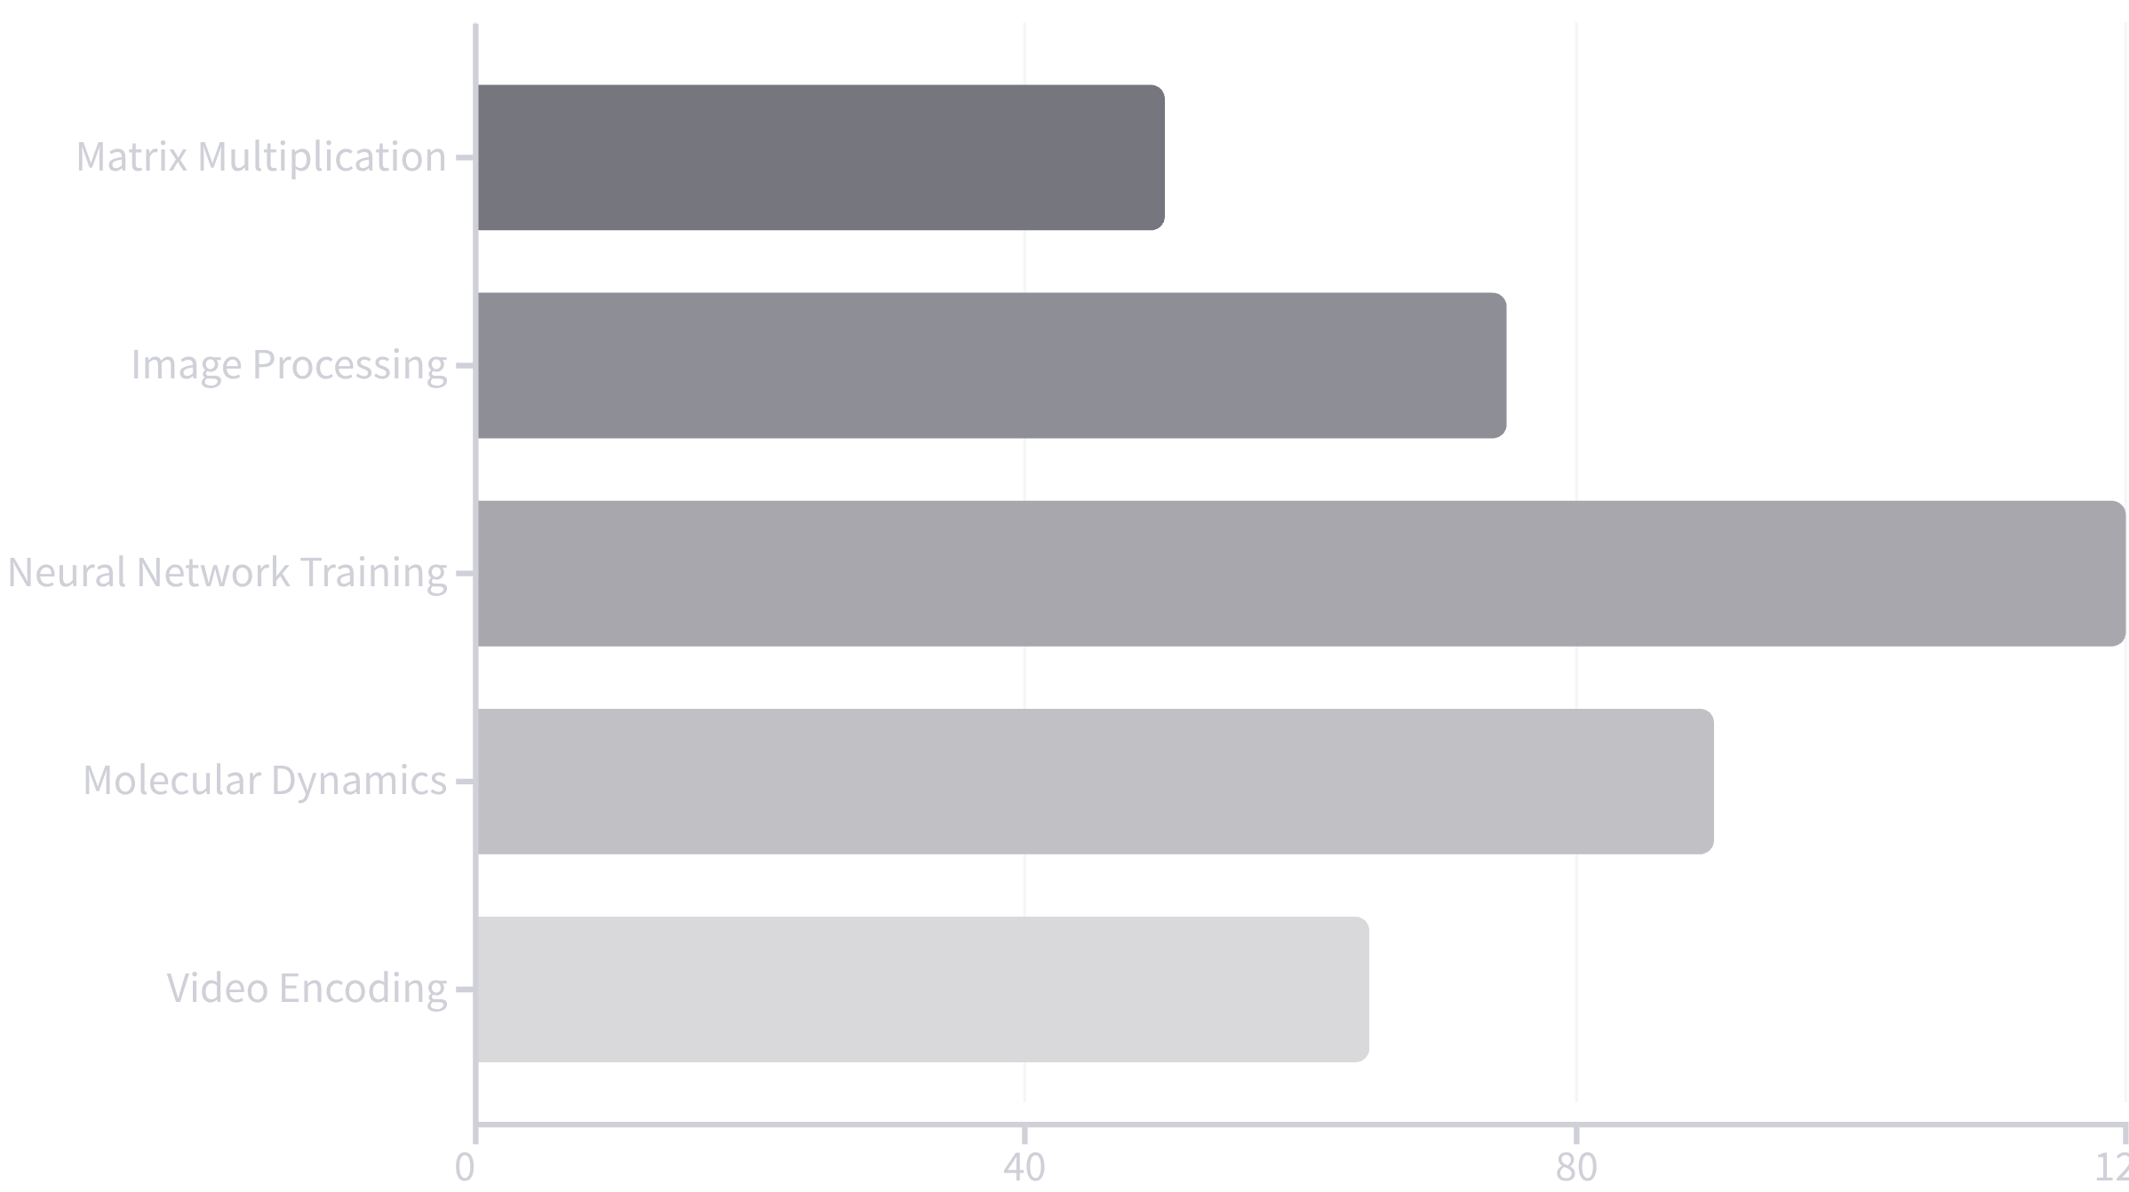
Performance Comparison
GPU acceleration delivers dramatic speedups for parallel workloads compared to traditional CPU execution:
These speedups represent typical performance gains when moving from optimized CPU code to well-written CUDA implementations.

Slide 9




Optimization Strategies
Memory Coalescing
Occupancy Optimization
Minimize Divergence
Coalesce your global memory accesses, by having threads access sequential addresses
Tune your block size, register count and shared memory usage to get maximum threads per SM
Minimize warp divergence, threads in a warp must stay in lockstep for highest performance
CUDA Pro Tip: Use Nsight tools from NVIDIA to profile your CUDA code, the most significant performance issues can often be related to simple memory access patterns

Slide 10

CUDA Setup and First Steps Guide
Basic Setup
Install CUDA Toolkit (nvcc compiler)
Install NVIDIA Nsight for debugging/profiling
cuBLAS, cuFFT libraries for optimized routines
Documentation and sample programs are included
Learning Resources
NVIDIA Developer Zone (tutorials)
CUDA C Programming Guide
Start with simple examples (vector addition) then progress to more complex apps as you grasp the fundamentals.
Online courses (Udacity, Coursera)
Community forums and GitHub examples

Slide 11






Important Lessons
Huge Parallelism
Programming that is accessible
Optimisation Is Important
CUDA provides order-of-magnitude speedups for data-parallel tasks by opening up thousands of GPU cores for general-purpose processing.
Developers can learn parallel programming more easily with familiar C/C++ syntax and GPU-specific features.
Achieving optimal performance requires an understanding of GPU architecture, thread organisation, and memory structures.
By making GPU acceleration feasible and affordable, CUDA has revolutionised scientific computing, artificial intelligence, and numerous other domains. Parallel programming abilities are becoming more and more important as applications become more data-intensive.

Slide 12
The End

